Slide 1
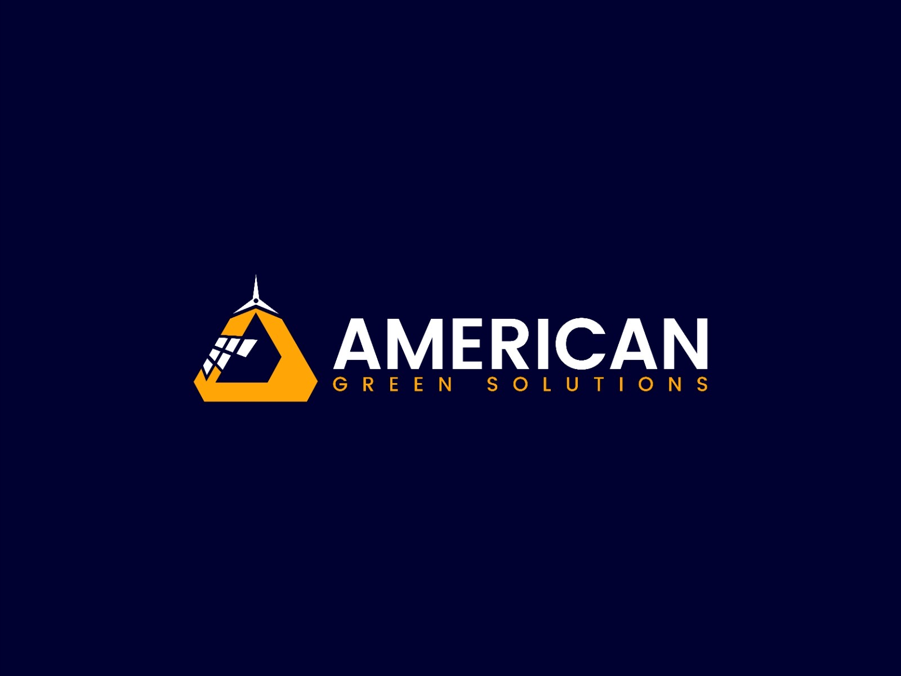
American Green Solutions
Content for Website Design
Home Page

Slide 2
Home
Our Mission:
Our mission is to protect and accelerate investments in clean energy through one industry-leading service: Performance Assurance. We have tailored this service with options that are right for you.
With American Green Solutions, you can trust that your solar system is in capable hands. Our expert team monitors your system round the clock and remotely detects any issues. If attention is required, we will promptly notify you and take the necessary steps to rectify the situation, so you can have peace of mind.
We offer performance assurance for solar investments, whether it's a single system or a large portfolio. Our commitment goes beyond mere monitoring, as we can even provide a guarantee for annual energy generation. With American Green Solutions, you can rest assured that your solar investment will deliver the expected returns.
Why Choose Us ?
Set It and Forget It
Performance, Guaranteed!!

Slide 3
Powered by cutting-edge technology, American Green Solutions' services include advanced issue detection and diagnostics. Our algorithms remotely identify the root cause of any problems, be it shading, soiling, weather-related issues, or component failure. Our team of experts then promptly handles the solution, ensuring efficient system performance.
With personalized reports that consider real-world factors like weather conditions, you will always have visibility into how your solar investment is performing and why. Our 24/7 monitoring and rapid remote diagnostics optimize your return on investment. You remain in control with American Green Solutions.
Our knowledgeable team is highly experienced in solar system issues and often identifies problems before you even notice them. We are committed to providing excellent customer support, promptly addressing any concerns or questions you may have. Our solar experts are just a call or click away
We offer 24/7 customer support including federal holidays, to ensure that our clients always have the help they need when they need it. Our support team is highly responsive and works quickly to resolve any issues or concerns that our clients may have.
American Green solution currently providing monitoring services for 750 MW+ sites across US.
Intelligent System Diagnostics
Transparency and Control
EXPERTISE
Support
Stats

Slide 4
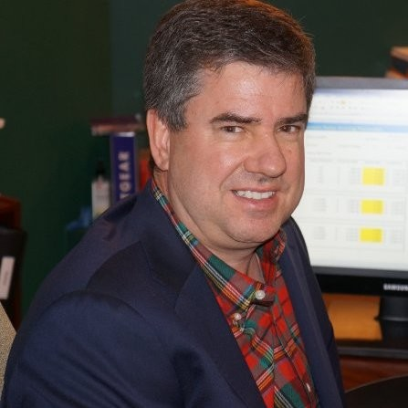

Testimonials
Brett Chapman
Vice President of Operations at Ameresco
“Most of the vendors in this space offer only weekday monitoring that ends with sunset. At Libsys, I was provided with Weekday, Weekend, Overnight monitoring that helped us scale our efficiency significantly.”
Nick Manna
Operations Manager at Amresco
“Libsys has an advantage in the Solar O&M space with their exceptional customer experience and after sales response. The swift responses to our last minute requests and the professional team who jumped right into the job made our lives easier.”

Slide 5
Solutions/Services - Overview
→Ensuring Performance for Commercial Solar Owners & Operators
We manage the performance of commercial solar systems, including rooftop, ground-mount, and carport projects, with our teams of solar experts.
→ Community Solar Solutions
American Green Solutions maximizes solar farm production and value for C&I scale and Community Solar projects. We offer industry-leading asset performance management services for landowners and large-scale solar asset owners. With our advanced proactive monitoring solution, we identify potential issues early on. Our team of vetted technicians, available locally across the U.S., provides preventive and corrective maintenance, along with auxiliary services.
→Ensuring return for Portfolio Investors
American Green Solutions maximize your solar portfolio's return and unlock your capital. We assume maintenance risks and ensure energy generation throughout your investment's lifetime. Start with a detailed analysis of asset-level performance for existing portfolios. Achieve the promised performance and expected ROI.
Custom Analytics
Gain immediate insight into performance progress through custom analytics, including specific indicators and performance analytics. Integrate verified weather forecast data to forecast energy production. Access analysis of production losses compared to ideal data, allowing for tailored alerts to track underperforming plants. Track and categorize factors impacting plant performance.

Slide 6
References 1. https://www.omnidian.com/ - Top priority, best suites for role. 2. https://www.ameresco.com/ 3. https://www.borregoenergy.com/ 4. https://www.stratacleanenergy.com/about 5. https://greenbackercapital.com/ 6. https://www.cleanmax.com/ 7. https://skyfri.com/ 8. https://be-cis.com/ 9. https://renewpower.in/

